Slide 1
Front End Engineering-I Project
Team Details:
Fahaam Khan: 2210990309
Gagan Deep: 2210990310
Gagan Sharma: 2210990311
Gagandeep: 2210990312
Faculty Coordinator: Dr.Monika Sethi
:
Chitkara University Institute of Engineering and Technology,
Chitkara University, Punjab

Slide 2
Table of Contents
Introduction
Problem Statement
Technical Details
Key Features
Project Highlights
Conclusion
References/Links used

Slide 3
Introduction
This project emphasizes the importance of the internet and search engines like Google in our daily lives for accessing information quickly and efficiently. We have created a search engine frontend that looks and feels like Google, with features such as autocomplete suggestions and filters for search results. Users can simply enter their search query into the search bar and explore the results. The project aims to provide a visually appealing and user-friendly search engine that delivers accurate results. It also includes replicas of various login pages for popular websites.
In this project we make a replica of the Google Search Engine with the help oh the HTML & CSS. In this we make only a Frontend of the Google Search Engine, where we find the login page of Gmail, WhatsApp login, Facebook login, YouTube and many more…

Slide 4
Problem Statement
Although Google search is one of the most widely used search engines on the internet, some users may prefer to use a search engine that has a different look and feel. Additionally, some users may have privacy concerns regarding their search history and may not want to use Google search for that reason.
To address this problem, I have created a search engine frontend that mimics the look and feel of the Google search engine. This frontend provides users with an alternative option to search for information on the internet in a visually appealing and user-friendly way. It also addresses privacy concerns by not tracking user search history, unlike the standard Google search engine.
Overall, the problem statement that motivated the creation of this project is to provide users with an alternative search engine option that respects their privacy and delivers accurate search results.

Slide 5
Problem Statement
Although Google search is one of the most widely used search engines on the internet, some users may prefer to use a search engine that has a different look and feel. Additionally, some users may have privacy concerns regarding their search history and may not want to use Google search for that reason.
To address this problem, I have created a search engine frontend that mimics the look and feel of the Google search engine. This frontend provides users with an alternative option to search for information on the internet in a visually appealing and user-friendly way. It also addresses privacy concerns by not tracking user search history, unlike the standard Google search engine.
Overall, the problem statement that motivated the creation of this project is to provide users with an alternative search engine option that respects their privacy and delivers accurate search results.

Slide 6
Technical Details
Document type declaration:
In our HTML file, we have included a document type declaration at the beginning. You can mention this in your file as well. For example, <!DOCTYPE html>
Tags: We have used different types of tags. These tags are as follows:-
HTML tags : <html><head><meta><link><title><body><style> <div><img><a><label><input><hr>,etc.
CSS tags:
*: This is a universal selector that targets all elements on the page.
body: This targets the body element of the HTML page.
.header: This targets the header element.
.header a: This targets all the links inside the header element.
.header a:hover: This targets the links inside the header element when they are being hovered over.
.header__right: This targets the element on the right side of the header.
.header_right .header_apps: This targets a specific element inside the header__right element.

Slide 7
Technical Details
.mainBody: This targets the main body element of the HTML page.
.mainBody img: This targets all the images inside the mainBody element.
.search__input: This targets the search input element.
.search__input input: This targets the input field inside the search input element.
.search__input .material-icons: This targets the material-icons class inside the search input element.
.search__buttons: This targets the search buttons element.
.search__buttons button: This targets all the buttons inside the search buttons element.
Browser compatibility: Our search engine is compatible with many browsers, such as Google Chrome, Firefox, and Safari. HTML and
CSS: To create the front-end of our search engine look alike, we have used HTML & CSS.

Slide 8
Key Features
Navigation:
We can navigate through different sites that we have added in the Nav bar. We have added Gmail, youtube and Google maps. The logos of these sites have links of the sites in them which redirects the user to these sites.
Header section:
The clone includes a header section with a logo, search bar.
Settings and My account option:
We have added the settings and my account option using the “on-click” functionality of java script.

Slide 9
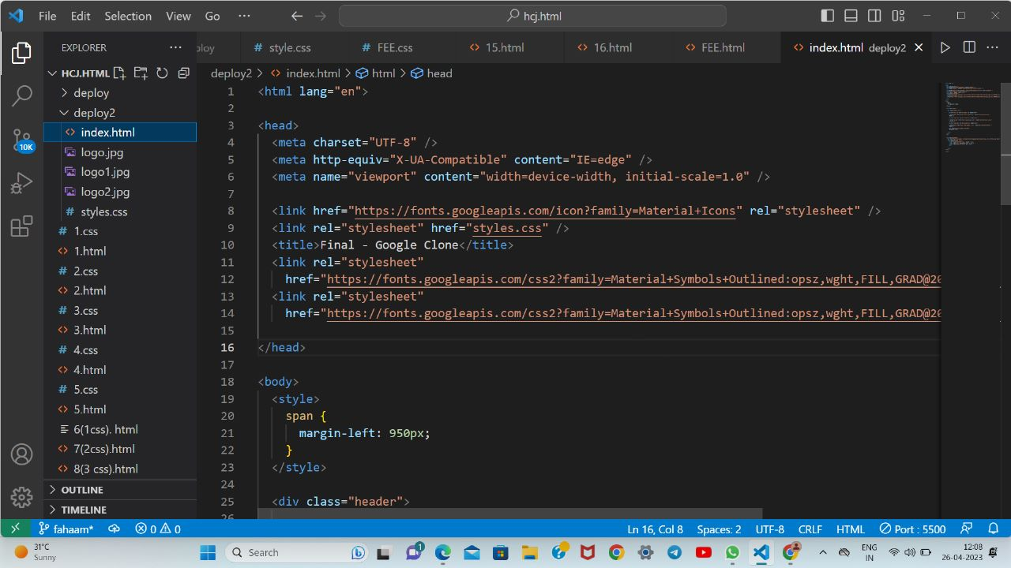
Project Highlights
HTML CODE:

Slide 10
Project Highlights
CODE EXPLANATION:
This is an HTML code that defines the structure and content of a web page. Here is a brief explanation of each section: The first line of code (``) declares the language of the document to be English. The `` section contains meta tags and links to external resources that the page requires. In this code, there are four meta tags: `charset`, `http-equiv`, `viewport`, and `title`. The `charset` tag specifies the character encoding used in the document (UTF-8, in this case). The `http-equiv` tag provides information about how the browser should handle certain features, such as compatibility mode. The `viewport` tag sets the width of the viewport to match the device's screen width, and the `title` tag sets the title of the page that appears in the browser's tab. Additionally, there are two links to external resources: one to the Google Material Icons font, and another to a CSS file called `styles.css`.

Slide 11
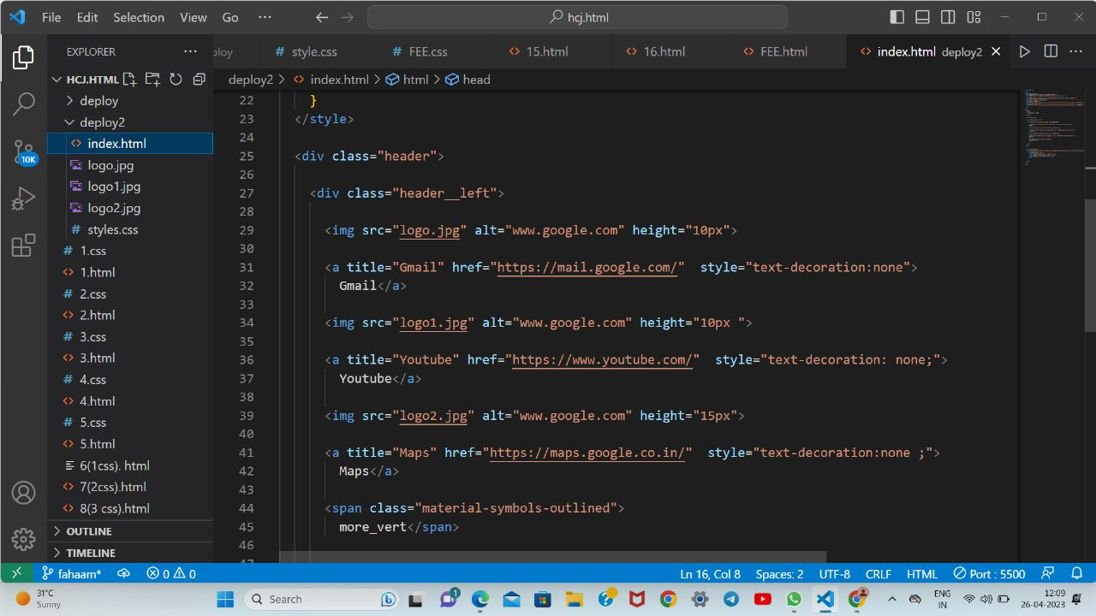
Project Highlights
HTML CODE:

Slide 12
Project Highlights
CODE EXPLANATION:
The `<body>` section contains the visible content of the page. In this code,
there is a `<style>` tag that defines a style rule for `<span>` elements, setting
their left margin to 950 pixels. The rest of the content is wrapped in a `<div>`
element with a class of "header". This code does not contain any actual content
within the `<div>` element, so it is unclear what the page is meant to display.
However, the external CSS file `styles.css` likely contains additional style
rules that affect the appearance of the page. In this we also placed three icons
with their working links Gmail, YouTube and Maps.
The <div="header_left">tag starts the left section of the header. The tags with src attributes of "logo.jpg", "logo1.jpg", and "logo2.jpg" are used to display images of logos with alt text "www.google.com" and different heights. The tags with title attributes of "Gmail", "Youtube", and "Maps" and href attributes of "https://mail.google.com/","https://www.youtube.com/",and"https://maps.google.co.in/" respectively, create links to these websites with the corresponding titles. The style attribute with text-decoration:none is used to remove underline from the link text. The last element, more_vert, displays a vertical ellipsis icon using Material Design Icons.

Slide 13
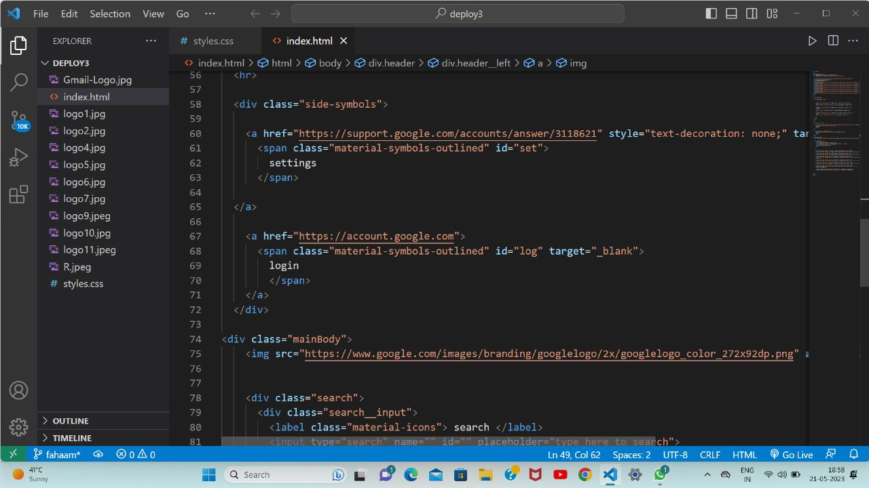
HTML CODE:
HTML CODE:

Slide 14
Project Highlights
CODE EXPLANATION:
<span class="material-symbols-outlined">: This is an HTML element that creates a small inline box used for styling text. It has a class attribute set to "material-symbols-outlined", which may be used for styling purposes.
more_vert: This is the text that is placed inside the <span> element.
<div class="mainBody">: This is a <div> element that is being used to group elements together. It has a class attribute set to "mainBody", which may be used for styling purposes.
<img src="https://www.google.com/images/branding/googlelogo/2x/googlelogo_color_272x92dp.png" alt="Google Logo" />: This is an <img> element that displays an image of the Google logo. The src attribute specifies the URL of the image, and the alt attribute specifies alternative text that is displayed if the image cannot be loaded.
<div class="search">: This is a <div> element that groups together elements related to search functionality. It has a class attribute set to "search", which may be used for styling purposes.
<div class="search__input">: This is a <div> element that groups together elements related to the search input field. It has a class attribute set to "search__input", which may be used for styling purposes.
<label class="material-icons"> search </label>: This is a <label> element that is used to label the search input field. It has a class attribute set to "material-icons", which may be used for styling purposes. The text "search" is placed inside the element.

Slide 15
Project Highlights
CODE EXPLANATION:
<input type="text" placeholder="type to search" />: This is an <input> element that creates a text input field for searching. The type attribute is set to "text", and the placeholder attribute provides a hint to the user about what should be typed in the field.
<label class="material-icons"> mic </label>: This is a <label> element that is used to label the microphone button that may be used for voice search. It has a class attribute set to "material-icons", which may be used for styling purposes. The text "mic" is placed inside the element.
</body> and </html>: These are closing tags for the <body> and <html> elements, respectively. They indicate the end of the HTML document.

Slide 16
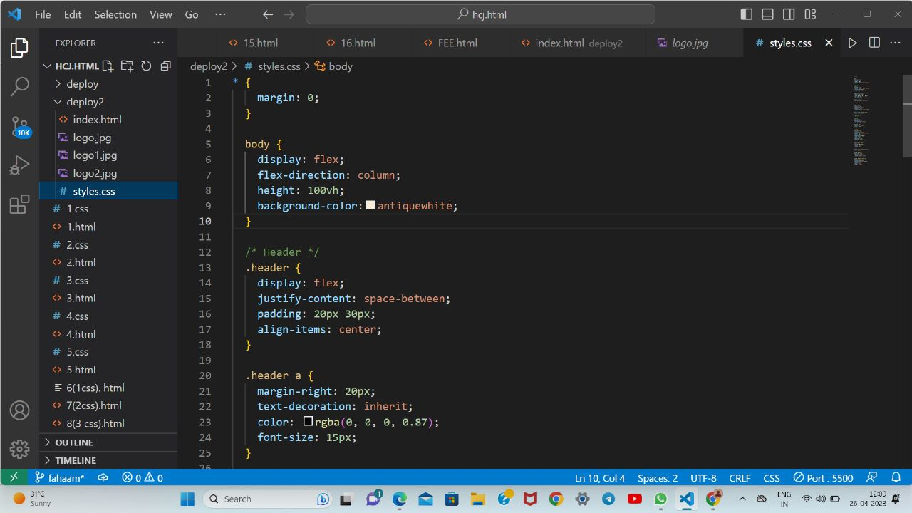
Project Highlights
CSS CODE:

Slide 17
Project Highlights
CODE EXPLANATION:
It starts with the universal selector, "*", which applies the margin property with a value of 0 to all elements in the HTML document. This ensures that there is no default margin added to any element.The next block of code targets the "body" element and applies several properties to it. The "display" property sets the element's display property to "flex", which means it will behave as a flex container. The "flex-direction" property sets the direction of the flex container to "column", which means the child elements will be stacked vertically. The "height" property sets the height of the container to 100% of the viewport height. The "background-color" property sets the background color of the body to "antiquewhite".The next block of code targets the element with class "header". It sets the "display" property of the element to "flex", which makes it a flex container. The "justify-content" property sets the horizontal alignment of the child elements inside the container to "space-between", which means there will be equal spacing between each element. The "padding" property sets the top and bottom padding of the container to 20 pixels and the left and right padding to 30 pixels. The "align-items" property sets the vertical alignment of the child elements to "center", which means they will be centered vertically.
The final block of code targets the anchor tags within the ".header" element. It sets the "margin-right" property to 20 pixels, which adds spacing between each link. The "text-decoration" property sets the text decoration of the link to "inherit", which means it will inherit the text decoration of its parent element. The "color" property sets the text color of the link to "rgba(0, 0, 0, 0.87)", which is a dark shade of gray. Finally, the "font-size" property sets the font size of the link to 15 pixels.

Slide 18
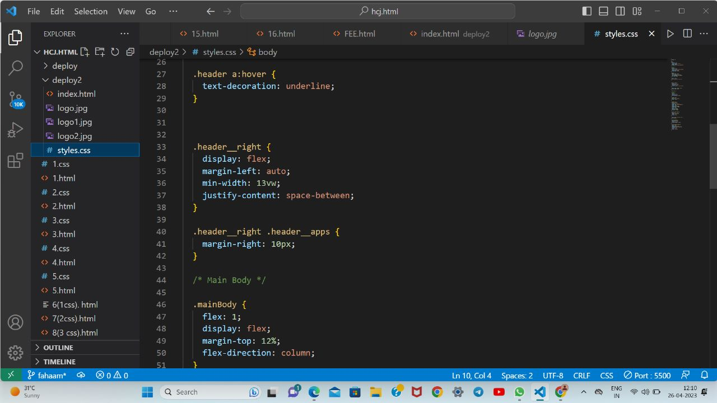
Project Highlights
CSS CODE:

Slide 19
Project Highlights
CODE EXPLANATION:
.header a:hover: This section applies styles to anchor (<a>) elements that are being hovered over by the user's mouse cursor. Specifically, it adds an underline to the text.
.header__right: This section applies styles to a container element with the class header__right. It sets the display property to flex so that the element is a flex container, and then sets margin-left to auto so that any remaining space is pushed to the right side of the container. It also sets min-width to 13vw so that the container is at least 13% of the viewport width, and justify-content to space-between so that any child elements are evenly distributed with space between them.
.header_right .header_apps: This section applies styles to an element with the class header_apps that is a child of an element with the class header_right. It sets margin-right to 10px to create some space between this element and its sibling elements.
.mainBody: This section applies styles to an element with the class mainBody. It sets flex to 1 so that this element grows to fill any available space, and display to flex so that the element is a flex container. It also sets margin-top to 12% to create some space above this element, and flex-direction to column so that its child elements are arranged in a column layout.

Slide 20
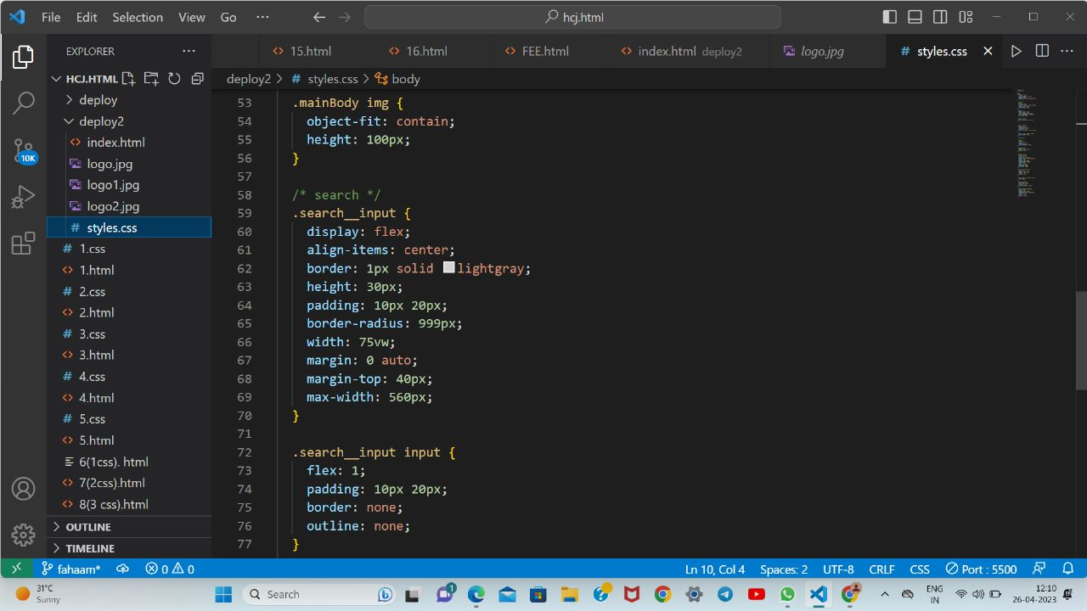
Project Highlights
CSS CODE:

Slide 21
Project Highlights
CODE EXPLANATION:
.mainBody img: This section applies styles to all <img> elements that are children of an element with the class mainBody. It sets the object-fit property to contain so that the image is resized to fit within its container while maintaining its aspect ratio, and it sets the height to 100px to ensure that all images are the same height.
.search__input: This section applies styles to an input element with the class search__input. It sets the display property to flex so that the element is a flex container, align-items to center so that the input element is vertically centered within its container, and sets a border with a 1px width and lightgray color. It also sets the height to 30px, padding to 10px 20px, border-radius to 999px to create a circular border, width to 75vw to make the input element fill up 75% of the viewport width, and sets margins to center the element on the page. Finally, max-width is set to 560px so that the input element doesn't become too wide on larger screens.
.search__input input: This section applies styles to the <input> element that is a child of the .search__input element. It sets the flex property to 1 so that the input element takes up any remaining space within its container, and it sets padding to 10px 20px, border to none and outline to none to remove the default styling for these properties.
These styles could be used to create a search input with a circular border and centered on the page, as well as to ensure all images in the main content area are the same height and fit within their containers.

Slide 22
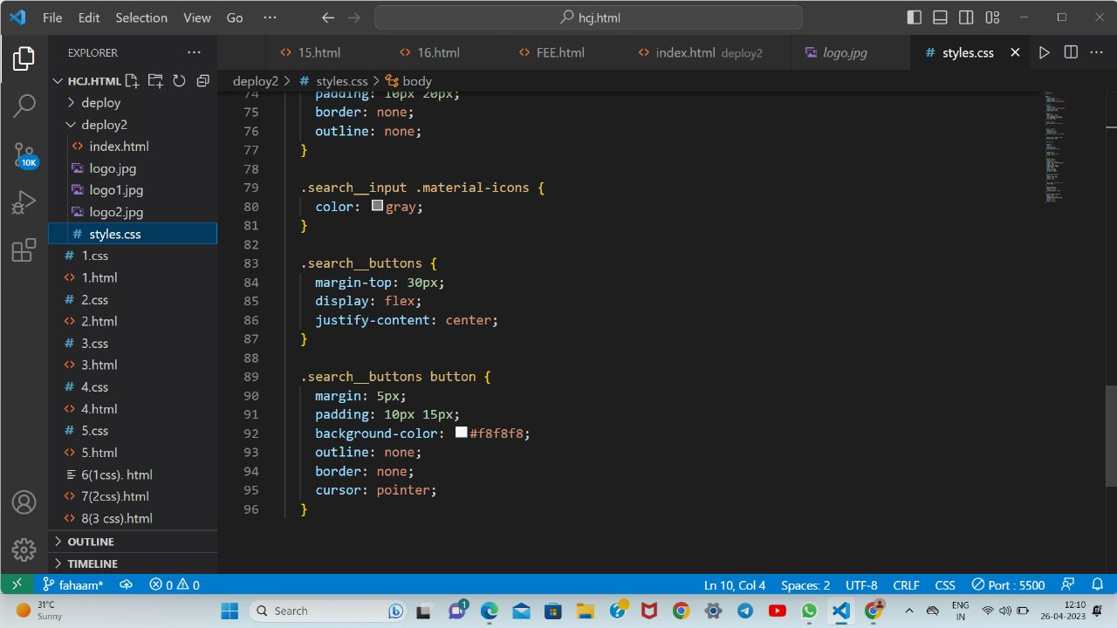
Project Highlights
CSS CODE:

Slide 23
Project Highlights
CODE EXPLANATION:
.search__input .material-icons: This section applies styles to any element with the class .material-icons that is a child of an element with the class .search__input. It sets the color of the icon to gray.
.search__buttons: This section applies styles to an element with the class .search__buttons. It sets the margin-top property to 30px to create space between the search input and the buttons, and it sets the display property to flex so that the buttons are arranged in a row. The justify-content property is set to center so that the buttons are horizontally centered within their container.
.search__buttons button: This section applies styles to all <button> elements that are children of an element with the class .search__buttons. It sets the margin property to 5px to create space between the buttons, and it sets the padding property to 10px 15px to create some internal spacing within the buttons. The background-color property is set to #f8f8f8 to set the background color of the buttons, and the outline and border properties are set to none to remove the default styling for these properties. Finally, the cursor property is set to pointer to indicate that the buttons are clickable.
These styles could be used to create a search input with buttons arranged in a row underneath it. The icons within the search input would be styled to be gray, while the buttons would have a light gray background color, be spaced evenly, and have no visible border or outline.

Slide 24
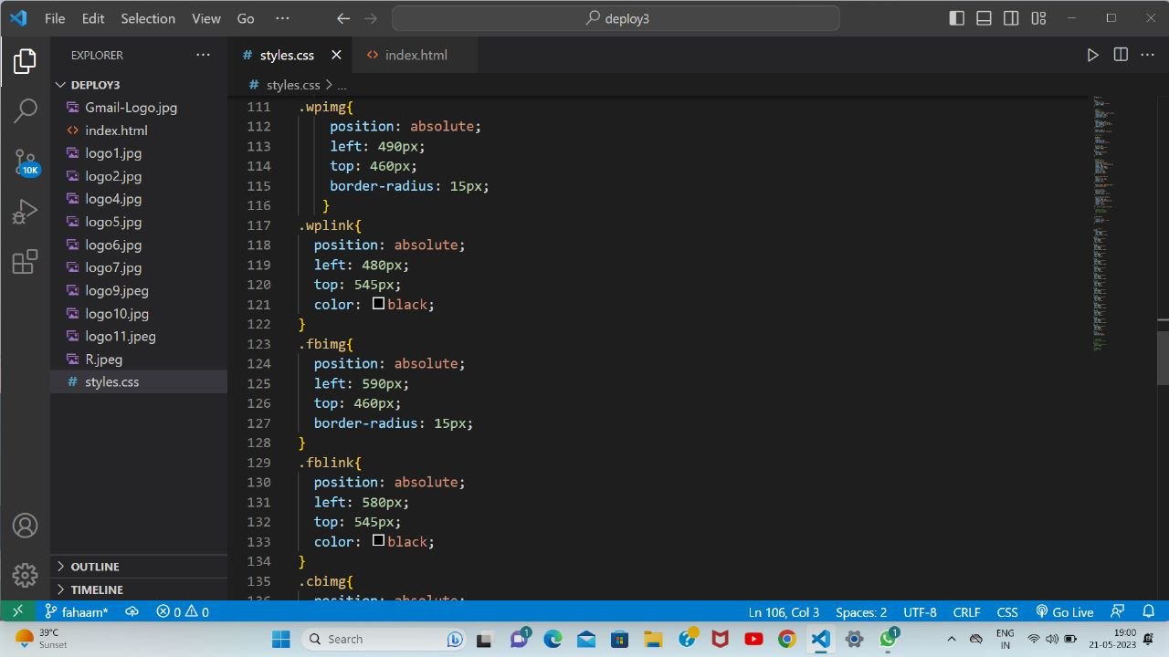
CSS CODE:

Slide 25
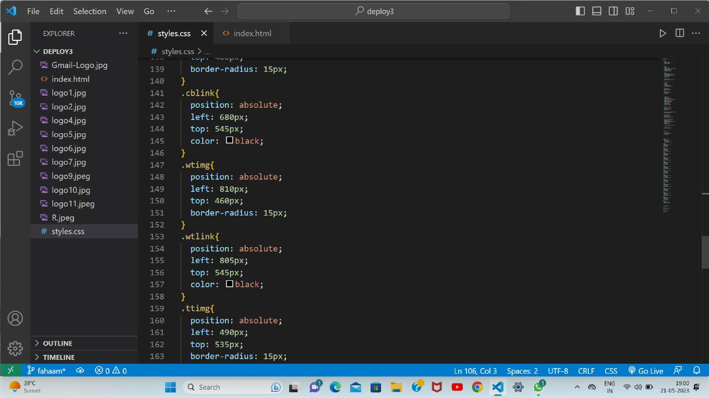
CSS CODE:

Slide 26
Code Explanation:
We have written the code for the icon shortcuts that are placed below the serach bar using the margin functionality. Within this CSS code snippet, we define a CSS class named "logo-link," specifically targeting the links embedded within image logos. By utilizing the position: absolute property, we ensure that the links are positioned absolutely within the parent container, relative to the nearest positioned ancestor.The top: 0 property is specified to align the links at the top of the container. However, this value can be adjusted to suit different vertical alignments, such as top: 10px or top: 50%, depending on the desired positioning.To provide even greater flexibility, additional properties can be incorporated within the curly braces of the CSS class. These properties could include left, right, bottom, or additional values like margin, padding, display, or z-index as per the specific requirements of your project.

Slide 27
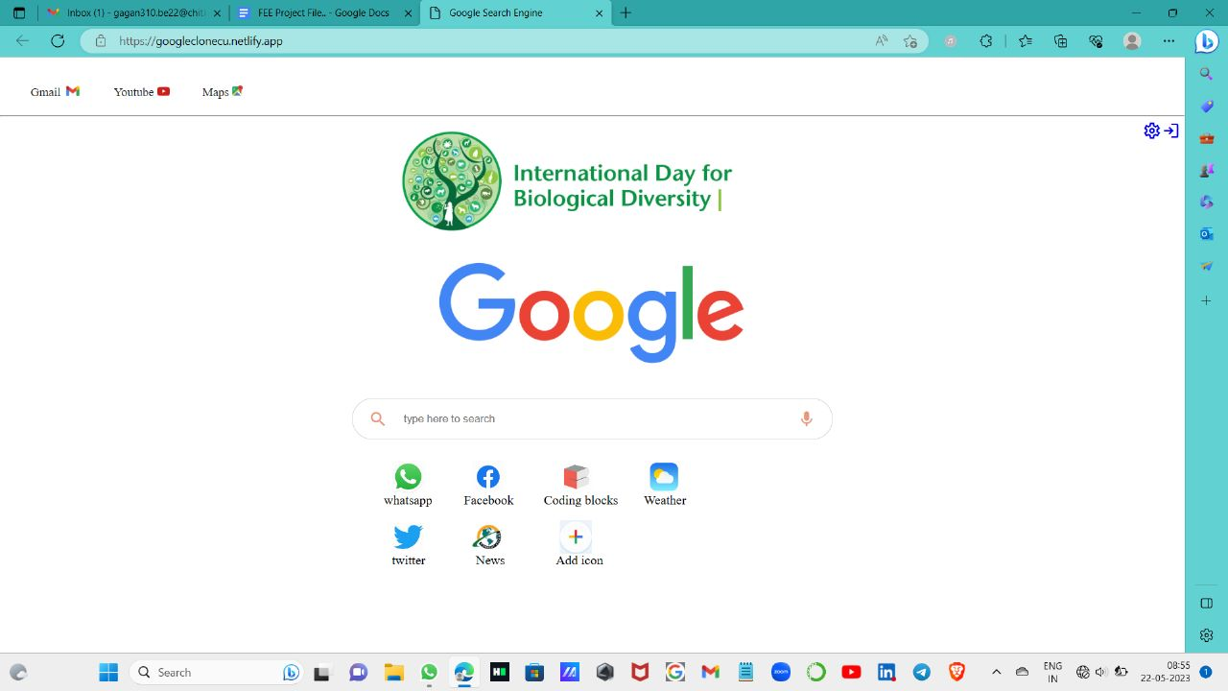
Solution of the Project:
Final Outcome:

Slide 28
Conclusion
In conclusion, by mimicking the look and feel of Google search, users can comfortably use this frontend to search the web while also maintaining their privacy.
Throughout the project, I focused on creating a user-friendly and visually appealing interface, while also ensuring that the search results are accurate and relevant. Additionally, I prioritized the privacy of the users by not tracking their search history.

Slide 29
References/Links used
Here are all the links present in the code:
- https://fonts.googleapis.com/icon?family=Material+Icons
- styles.css
- https://fonts.googleapis.com/css2?family=Material+Symbols+Outlined:opsz,wght,FILL,GRAD@20..48,100..700,0..1,-50..200
- https://mail.google.com/
- https://www.youtube.com/
- https://maps.google.co.in/
- https://web.whatsapp.com
- https://www.facebook.com
- https://www.codingblocks.com
- https://weather.com/en-IN
- https://twitter.com/
- https://www.gktoday.in/current-affairs
- https://www.google.com/images/branding/googlelogo/2x/googlelogo_color_272x92dp.png

Slide 30


